Slide 1
Second Annual International TESOL Conference Hue, Vietnam
High Motivation – Low Anxiety Techniques for Teaching
Listening and Speaking Skills
by
Dr. Mary Ellen Butler-Pascoe
TESOL Program
Alliant International University
San Diego, California, USA

Slide 2
Teaching Listening Skills: Providing Comprehensible Input
A key role of the of the second language teacher is to act as a facilitator in providing comprehensible input to assist students in converting “input “ into “intake”
Listening is a critical receptive skill that typically precedes productive ability (such as speaking)
In the language classroom and outside the class, students engage more in listening than they do in speaking.

Slide 3
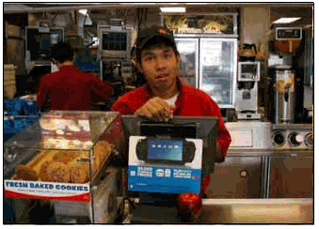
Comprehensible Input: “FORHEREORTOGO”
Cashier
Why can't this customer understand what I'm saying? I have repeated "forhereortogo" three times. I even said the words very slowly the last time. He must not understand any English.

Slide 4
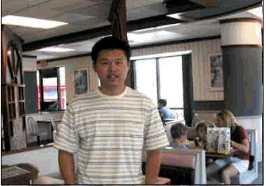
Comprehensible Input: “FORHEREORTOGO”
Customer
What does ‘forhereortogo’ mean? Even when the cashier asks me slowly, I understand the words but I don’t know what the words mean.

Slide 5
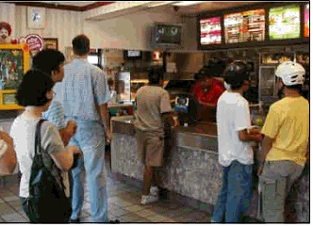
Comprehensible Input: “FOR HERE OR TO GO?”
“
Helpful English-speaking Customer - “For here or to go?”
The cashier wants to know if you would like to eat your food here in the restaurant or would you like it to go home with you. Is your food for here or to go home?

Slide 6
Top Down & Bottom Up Process

Slide 7
Principles for Teaching Listening and Speaking Brown, H.D.; Peterson, P. .
Integrate listening practice into the class.
Don’t assume comprehension competence “just happens”—Allow more listening time.
Include both global (gist of message) and focused listening (form and accuracy).
Appeal to students’ intrinsic motivation.
Include students’ interests, goals and abilities.
Use authentic language in meaningful contexts.
Highlight relevance to real-life needs.

Slide 8
Principles for Teaching Listening and Speaking
Consider how students will respond.
Listening cannot be seen; we must infer students’ comprehension from their responses
Teach conscious listening strategies for beyond the classroom.
Listen for key words, guess at meaning,
observe non- verbal cues; seek clarification;
guess at meaning from context, listen for
general ideas; listen for details.
Engage both bottom-up (linguistic knowledge) and top-down (background knowledge) listening processes.

Slide 9
Principles for Teaching Listening and Speaking
Focus on fluency and accuracy in speaking (depending on lesson/activity objective).
Provide appropriate feedback and correction.
Optimize the natural link between listening and speaking.
Give students the opportunity to initiate oral communication.
Develop speaking strategies: Using fillers (“Well,” “Um,”); using conversation maintenance cues (“uh-huh,” “right,” “yeah,” “okay”); getting someone’s attention (“Excuse me”).

Slide 10
Low Anxiety Activities for Teaching Listening and Speaking
Information gap activities
Games
Jigsaw tasks
Ranking exercises
Discussions
Real-world tasks
Problem-solving activities
Internet activities (WebQuests)
Role plays
Charts and timelines
Songs, plays, poems
Chat

Slide 11
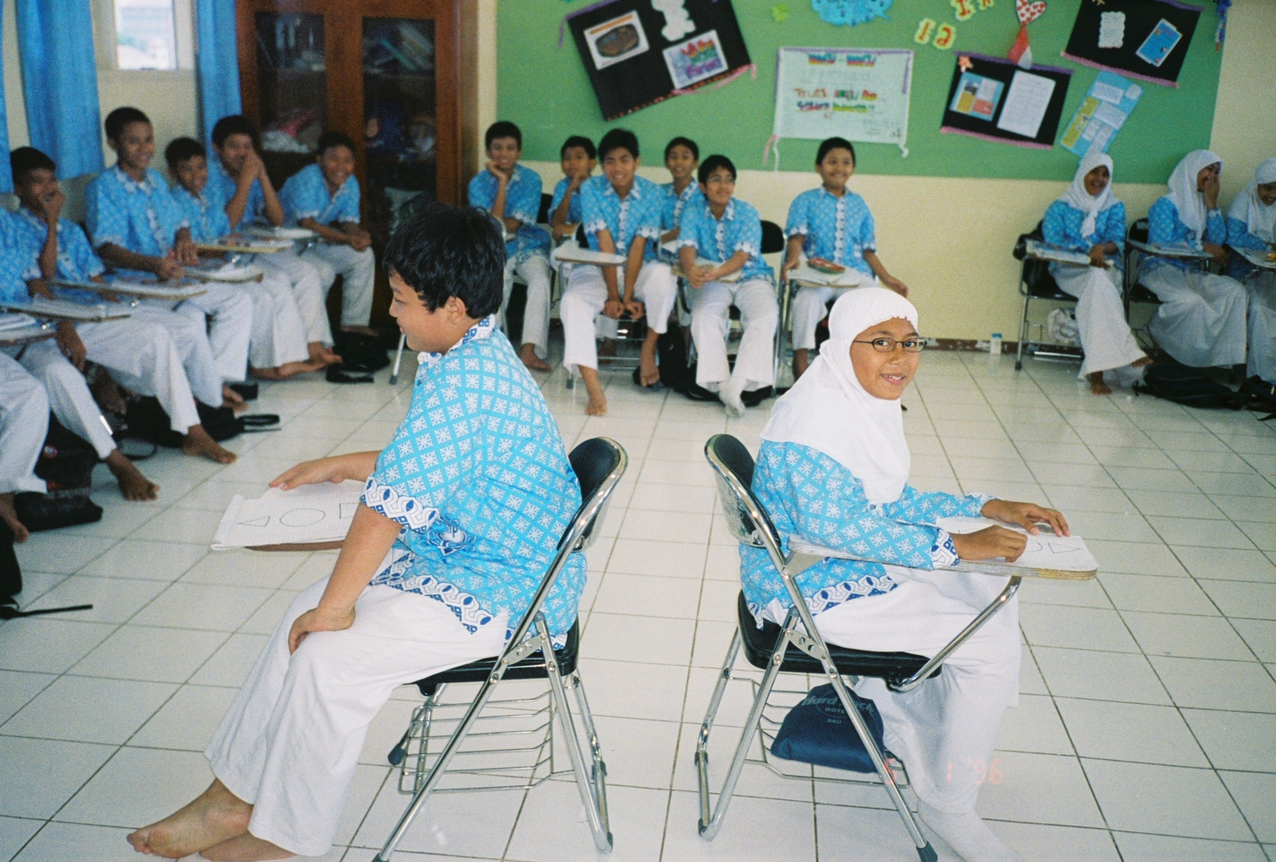
Notes:
Do

Slide 12
Events in Lance’s Life

Slide 13
Technology Attributes that Support Listening and Speaking
Technology provides
Low affective filter—decreases anxiety.
Collaboration—provides opportunities for using the language for negotiation and for group activities.
Motivating activities to stimulate discussion—inspires students to communicate via and around the computer.
Different Learning styles—Multimedia meets needs of all learners (Visual, kinesthetic, aural, etc.).
Feedback and Assessment --Students can listen, record and/or store oral communication and receive feedback. (VoiceThread, podcasts, etc.).

Slide 14
Low anxiety-High Motivation Technology-based Resources
Examples:
Breaking News English (Listening)
QuestGarden (Task-based listening and speaking)
VoiceThread (Speaking and feedback)
Hot Potatoes (Integrated skills)
Podomatic (Speaking via podcasts)
Randall’s ESL Cyber Listening Lab (Listening)
TEFL/TESL/TESOL Links (Listening and Speaking/Pronunciation)

Slide 15
http://www.breakingnewsenglish.com/

Slide 16
Breaking News English http://www.breakingnewsenglish.com
PRINT
13-Page PDF Handout
LISTEN
MP3 (2:00 - 963KB)
QUIZZES
Fill-in-the-blank
Matching
Hangman
Flash cards
Sentence jumble
Missing words
No letters
Crossword

Slide 17
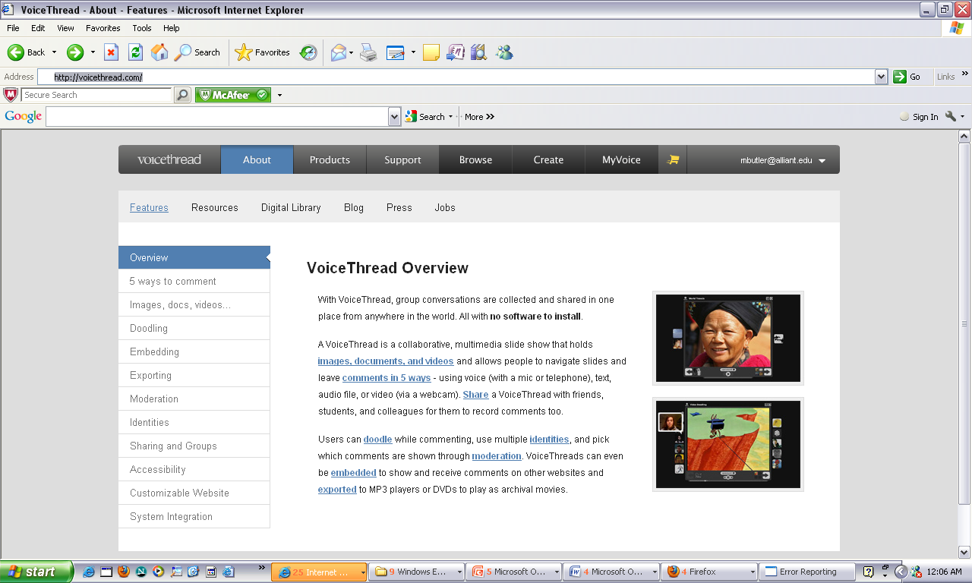
VoiceThreads http://voicethread.com/#q.b1288581.i6908396

Slide 18
Voicethreads: http://Voicethread.com
A VoiceThread is a collaborative, multimedia slide show that holds images, documents, and videos
Allows people to navigate slides and leave comments in 5 ways - using voice (with a microphone or telephone), text, audio file, or video (via a webcam).
Share : A VoiceThread with friends, students, and colleagues for them to record comments too.

Slide 19
VoiceThread http://voicethread.com/#q.b1288581.i6908396

Slide 20
VOICE THREAD

Slide 21
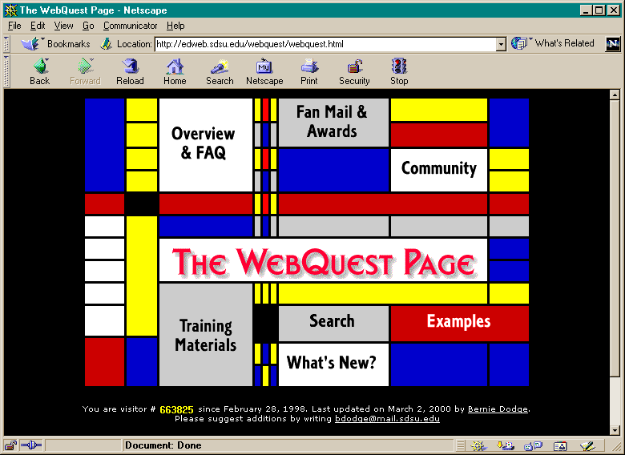
WebQuests
A WebQuest is an task-based activity designed by teachers that uses webpages to present the task to the students.
Example: Exploring Cultures from Around the World http://www.ouralliant.com/edu6072/su09/aschorr/webquest/
The Webquest has several components:
Introduction
Task
Process
Evaluation
Conclusion
Teacher’s Page

Slide 22
Topic and Name Page

Slide 23
Introduction

Slide 24
The Task

Slide 25
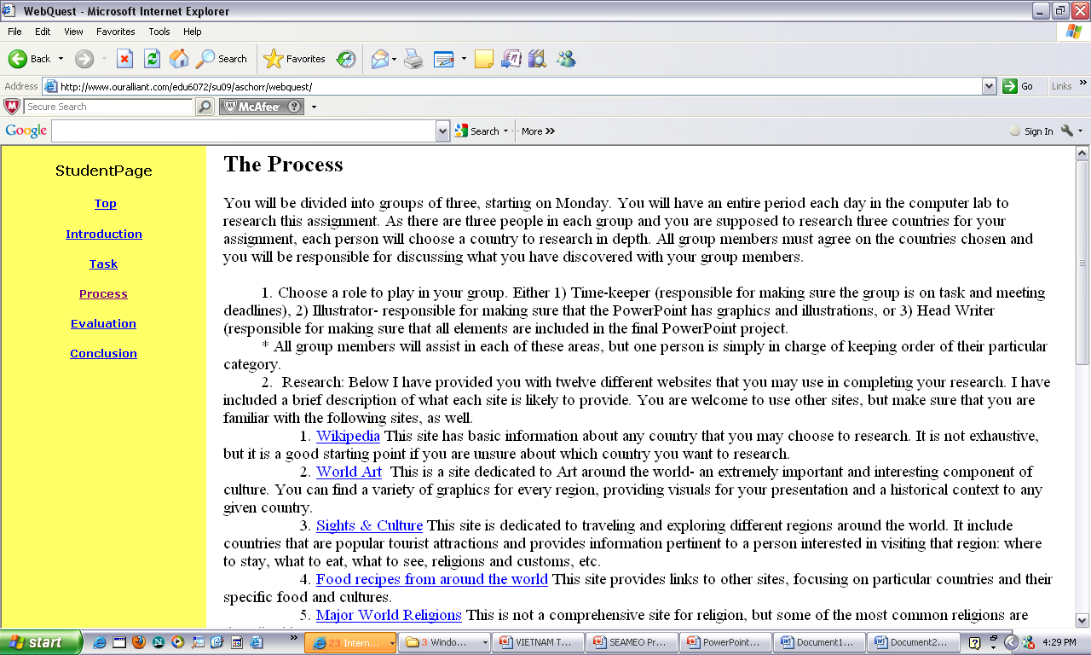
The Process: Googling to Identify Website Resources http://www.google.com

Slide 26
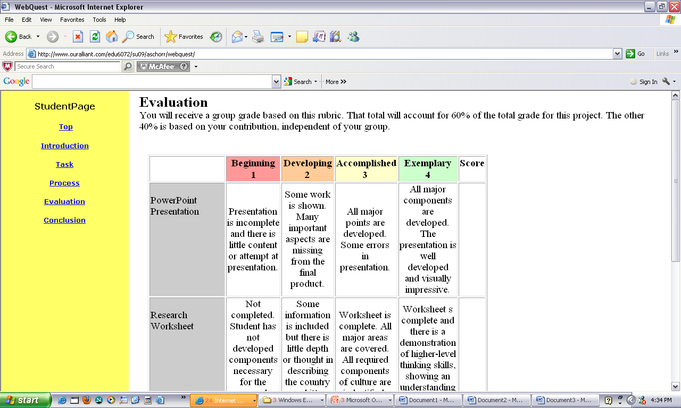
Evaluation

Slide 27
QuestGarden is an online authoring tool and hosting service that is designed to make it easier and quicker to create WebQuests. http://questgarden.com/

Slide 28
WebQuest Template

Slide 29
Podomatic: Podcasts made easy http://www.podomatic.com /

Slide 30
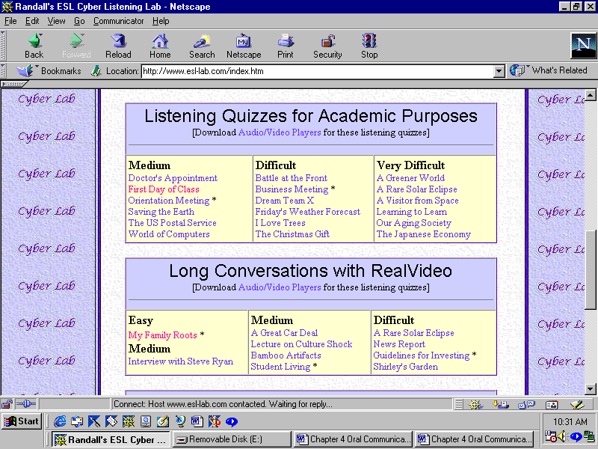
Randall’s ESL Cyber Listening Lab http://www.esl-lab.com

Slide 31
Randall’s ESL Cyber Listening Lab http://www.esl-lab.com

Slide 32
TESL/TEFL/TESOL/ESL/EFL/ESOL Links: http://iteslj.org/links/

Slide 33
TESL/TEFL/TESOL/ESL/EFL/ESOL Links: http://iteslj.org/links/

Slide 34
TESOL Links: Pronunciation Minimal Pairs

Slide 35
Thank You!!!
PowerPoint available at faculty webpage of
Dr. Mary Ellen Butler-Pascoe, mbutler@alliant.edu
Professor and Director of TESOL Master’s and Doctorate Programs Alliant International University Shirley M. Hufstedler School of Education San Diego California, USA
http://www.alliant.edu/

